Slide 1


MANAGING THE FLOATING-OBJECT FISHERY FOR TROPICAL TUNAS IN THE EPO: SUPPORTING INFORMATION FOR THE PRECAUTIONARY ADDITIONAL MEASURES RECOMMENDED BY THE STAFF
Jon Lopez, Cleridy E. Lennert-Cody, Mark N. Maunder, Alexandre Aires-da-Silva, Haikun Xu, Carolina Minte-Vera, Juan L. Valero, Jean Francois Pulvenis, Guillermo Compeán
Document SAC-11 INF-M, 11th meeting of the SAC

Slide 2

Outline
Background
Management measures considered
  Limit the number of OBJ sets
  Adjust the limits on daily active FADs
  Limit FAD deployments
  Adjustments to days of closure
  Conclusion

Slide 3
Background
The IATTC staff’s 2020 risk analysis (SAC-11-08) indicates that the current management measures (C-17-02) are adequate in the short term.
Nonetheless, the staff is recommending additional precautionary measures to ensure status quo conditions—defined as the average fishing mortality (F) during the most recent 3-year period (2017-2019)—are not exceeded, for two reasons:
  For bigeye tuna, the risk analysis estimates a 50% probability that current fishing mortality (F_{cur}) is higher than the target reference point of maximum sustainable yield (MSY). However, the results of the risk analysis are bimodal (SAC-11-08), with both a more pessimistic and a more optimistic group of models. The combined models in the pessimistic group indicate a 10% (or slightly higher) probability that the limit reference point has been exceeded;
  Stock status indicators (SAC-11-05), in particular those for the floating-object (OBJ) fishery, show long-term trends that could lead to increased F in the near future, thus jeopardizing the desired effect of the current measures for the purse-seine fishery (72-day closure, the corralito closure, daily active FAD limits per vessel).

Slide 4
Background
The staff has focused on the following four options, all directly applicable to controlling F, and/or already implemented in some form:
  Limit the number of floating-object (OBJ) sets;
  Adjust the limits on daily active FADs;
  Limit FAD deployments; and/or
  Adjust the duration of the closure to compensate for increases in OBJ sets.
The staff reviewed the advantages and disadvantages of each option, as well as potential solutions to mitigate or compensate for the disadvantages.

Slide 5
Limit the number of OBJ sets
Advantages | Disadvantages
Directly related to control fishing effort, and hence, F | Can lead to a ‘race’ to OBJ fishing, which may lead to hardly predictable changes in vessel behavior and promote inefficient or unsafe practices
Number of sets by type are available near-real time (weekly radio reports from vessels with observers) | May incentivize misreporting of information, including set type, and compromise scientific work in general
Does not penalize the fleet segment targeting NOA | In vessels without observers, real-time monitoring would require an additional data reporting mechanism
Does not allow total OBJ sets to increase (unlike a combined OBJ+NOA limit) | Relationship between number of sets and F may be variable and not proportional
Potential solutions
Allocation could reduce or eliminate a ‘race’ to make OBJ sets (e.g. see IATTC-90 INF-B; IATTC-90 INF-B Addendum 1).
An algorithm for predicting set type from observer data was developed, and could be adapted to identify misreported set types, although not in near-real time. Similar algorithms might be developed for other datasets (e.g. FAD form) but may not perform as well.
Vessels without observers could be required to transmit the same weekly catch and effort data sent by observers.
Advantages outweigh disadvantages. Directly controls F and is essential not to exceed status quo
Recommendation: a fleetwide annual limit on the number of OBJ sets
(15,987 OBJ sets, 2017-2019 annual average)

Slide 6
Adjust the limits on daily active FADs
Advantages | Disadvantages
Limits on active FADs, as well as a data reporting system, are in force since 2018 (Res. C-17-02) | The relationship between active FADs and OBJ sets per vessel appears to be poor for some fleet segments
A potential relationship between active FADs and OBJ sets has been suggested | Independent verification of the reported data is not available
Improves data quality by checking data provided by buoy manufacturers against other data sources | Vessels may share FADs, making the measure less effective
Active FAD data are already required to be reported to the staff monthly | Vessels can remotely deactivate and activate FADs (potentially increase with respect status quo). Note that C-17-02 forbids remote activation
Vessels could not increase the use of active FADs with respect to the status quo (unlike with adjustments to capacity-class limits in C-17-02) | Not all vessels are reporting active FAD data, permanently or partially
 | Wide variation in the use of FADs. Any fleetwide or capacity-class limits will impact some vessels more than others
Potential solutions
Access to high-resolution buoy data and VMS data would help conduct independent verification of the active FAD data, as well as progress in understanding the relationship between active FADs and number of OBJ sets.
Improving data reporting (mandated under C-17-02) would allow more accurate estimates of active FADs per vessel and globally.
Controls number of FADs at sea and efficiency, indirectly limits deployments. Essential not to exceed status quo
Recommendation: individual-vessel limits on the daily number of active FADs, computed independently for each vessel from its active FAD data for 2018-2019

Slide 7
Limit FAD deployments
Advantages | Disadvantages
Indirectly limits number of FADs at sea | Number of FADs at sea largely depends on recoveries
Mitigates the issue of remote activation | FADs may be deployed for purse-seines by unmonitored vessels
Observer data available for all IATTC Class-6 vessels | Deployments are not always directly visible to the observer
Potentially data for IATTC Class 1-5 vessels via FAD form | Data submission for the FAD form is currently incomplete
May indirectly limit number of OBJ sets | Modifications to/addition of data reporting infrastructure required to obtain data in near real-time
 | May incentivize misreporting of information
 | No verification algorithms exist for detecting misreported data, and unclear what could be developed with existing information
Potential solutions
Improve reporting rates and data quality for the FAD form.
Implementing an EMS program would greatly assist with obtaining more accurate tallies of FAD deployments (SAC-11-11).
The at-sea radio weekly reporting system could be modified to provide deployment information in near real-time.
Access to high-resolution buoy data and VMS data could allow independent estimation of deployments per vessel.
Disadvantages outweigh advantages: could promote deployments through alternative means, and compromise observer integrity and data quality.
Recommendation: do not put a limit on FAD deployments

Slide 8
Adjustments to days of closure
Advantages | Disadvantages
Measure specifying days of closure already adopted (Res. C-17-02) | DEL and NOA fisheries also will be impacted, despite current evaluation that yellowfin stock is healthy
Would not create incentives for misreporting of observer, FAD form or logbook data | Requires a forecast estimate of the future number of OBJ sets; current forecast methodology assumptions may be problematic
Does not generate additional demands for data and/or data processing infrastructure | Relationship between days open (365 – days of closure) and number of OBJ sets may not be proportional and may be variable
Does not require real-time monitoring of fishery
Potential solutions
Work is underway to investigate the relationship between days of closure and number of sets, including uncertainty about that relationship.
Disadvantages outweigh advantages: uncertainty about future number of OBJ sets is problematic
Recommendation: do not adjust days of closure

Slide 9
Conclusion
When management benefits are weighed against data and infrastructure issues, the staff concludes that a fleetwide limit on OBJ sets for all IATTC vessel size classes (i.e. 15,987 OBJ sets, the 2017-2019 average), combined with individual-vessel active FAD limits (to prevent a potential increase in number of FADs at sea and an increase in efficiency), will provide the best option not to exceed the status quo, preventing an increase in F within a management cycle.
The allocation method for the fleetwide annual limit on OBJ sets is a matter for the Commission to decide.

Slide 10

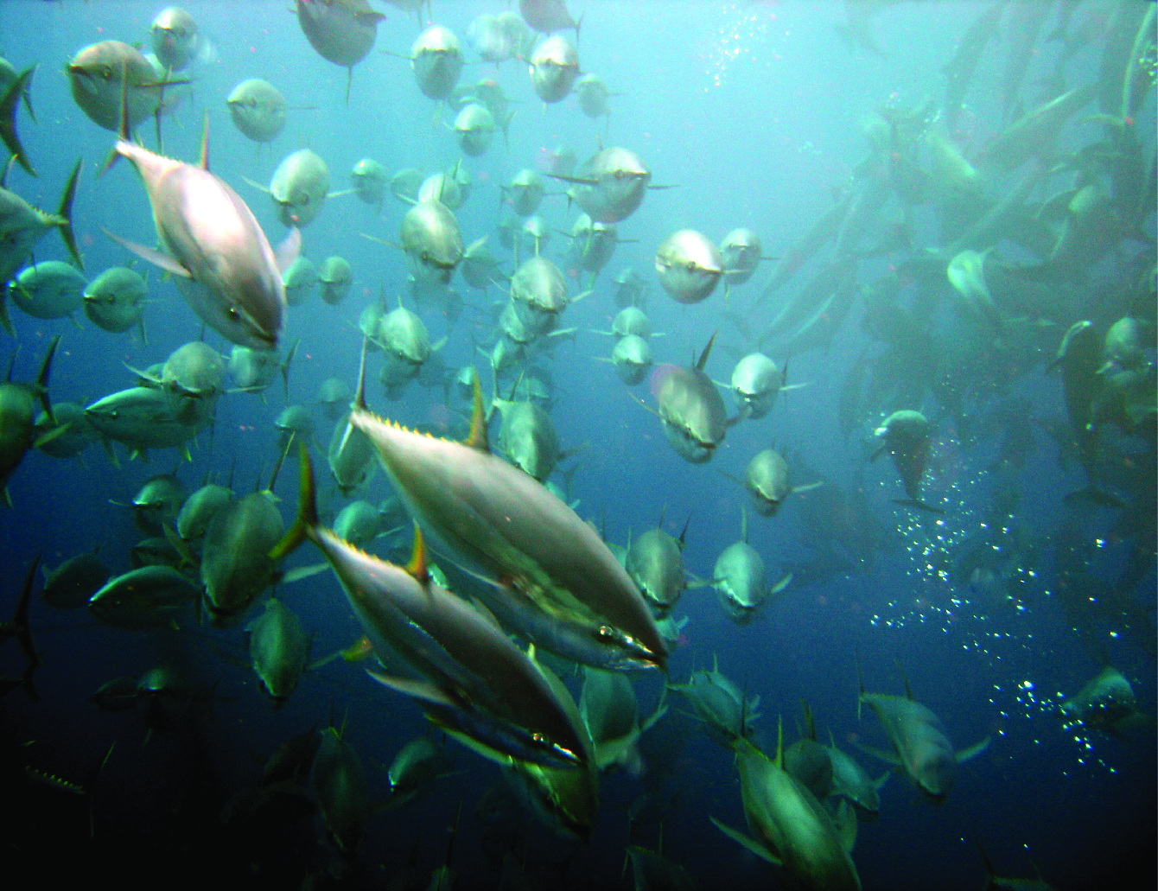
Questions

Slide 11
Additional slides

Slide 12
A combined OBJ and NOA sets limit
Both in 2018 and 2019, the staff proposed measures to prevent further increases in fishing mortality (IATTC-94-03, FAD-04-01). Specifically, the staff recommended (a) reductions of the active FAD limits, and (b) a limit on the total number of OBJ and NOA sets combined.
The staff is NOT proposing such a combined OBJ+NOA set limit in 2020, for three reasons:
  (1) yellowfin stock status is no longer a concern (SAC-11-07);
  (2) the possibility of exceeding existing OBJ set limits under a combined set limit is problematic; and
  (3) the staff recently developed a data verification algorithm to identify misreported set types in the observer data, and hopes to develop similar algorithms for other data sources.

Slide 13
Vessels reporting buoy data under Res. C-17-02
156 vessels reported active FAD data, partially or continuously in 2018-2019.
About 75% of the vessels reported during at least 12 months and 50% reported during at least 20 months.
Annually, vessels reporting buoy data accounted for over 80% the total number of sets on floating objects.

Slide 14
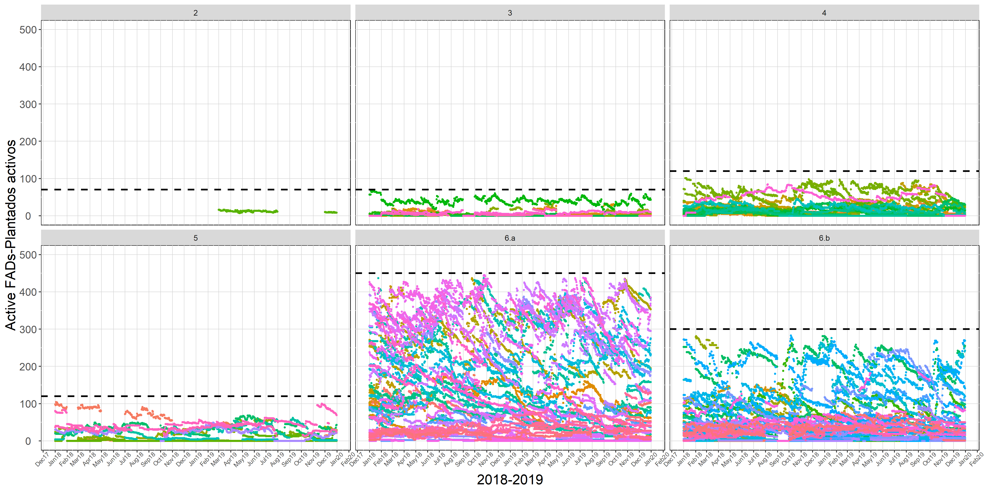
How to estimate individual vessel active FAD limits

Slide 15
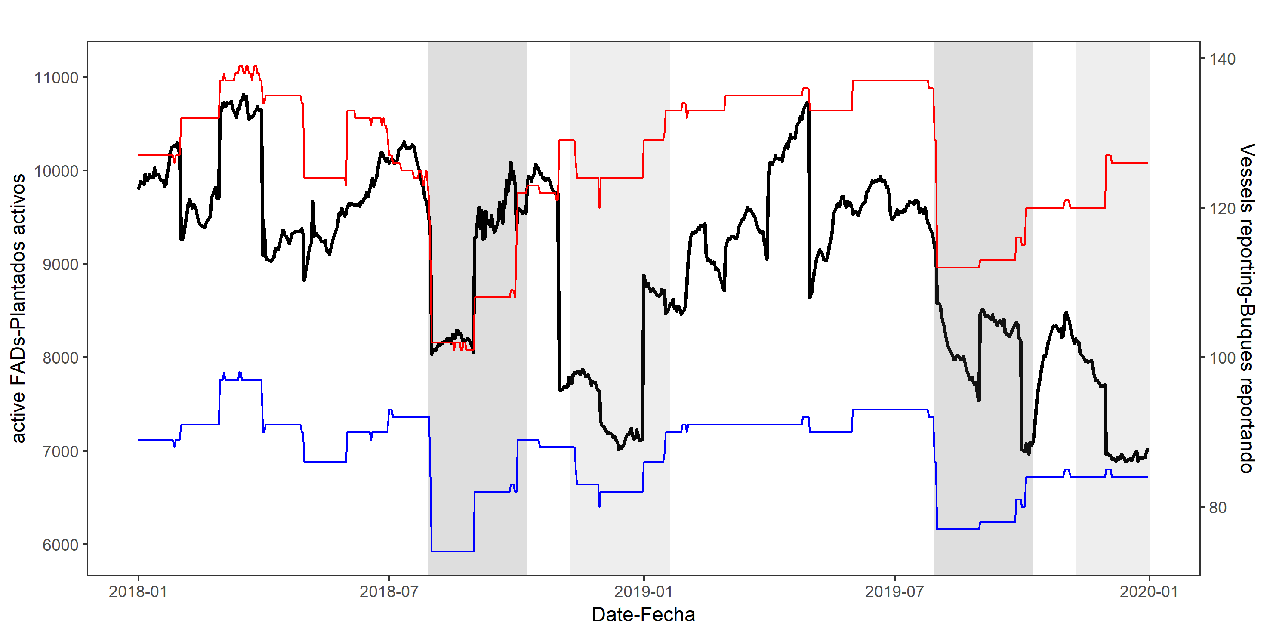
How to estimate individual vessel active FAD limits

Slide 16
How to estimate individual vessel active FAD limits
Staff’s proposal.
Data: 2018-219 active FAD data reported by each purse-seine vessel.
Method:
  Average of the maximum monthly number of active FADs(to account for seasonality)
  Closure periods will be excluded, as they may not represent accurate fishing/operational strategies for many vessels.
  For vessels reporting less than 12 individual months → report data ASAP (30 Nov 2020) → compute daily individual vessel limits.
  For vessels reporting zero months of data: limit would be zero.
    If active FAD data are reported: new limits would be computed.
    For vessels that have never fished on FADs but want to do it: equitable solution to be decided by the Commission, compatible with the thrust of the staff recommendations.

