Slide 1






MADE Symposium, 15 – 19 octobre 2012, Montpellier
Session 6: MITIGATION TECHNIQUES IN LONGLINE FISHERIES
Bait innovation as a new challenge in pelagic longlining
Bach P., T. Hodent, C. Donadio, E. Romanov, L. Dufossé, J.-J. Robin
Last fishing trials partially supported by European Fishing Funds

Slide 2
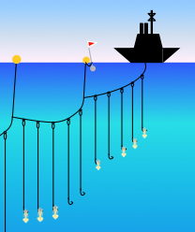
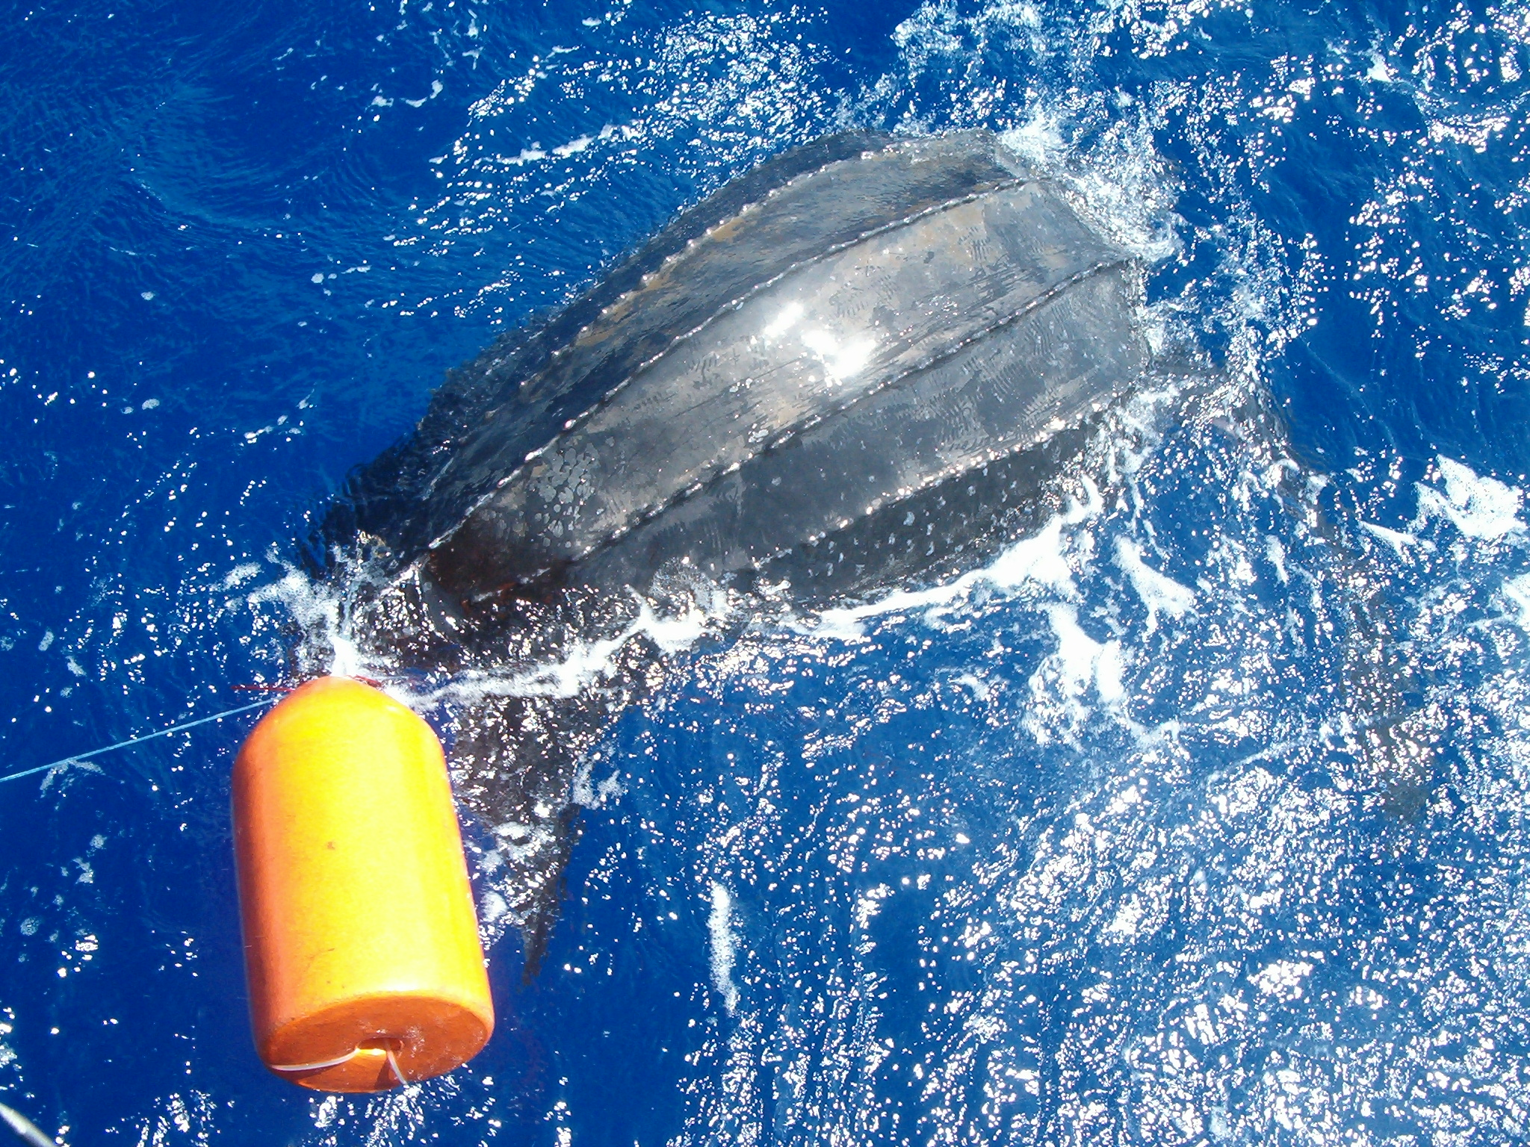
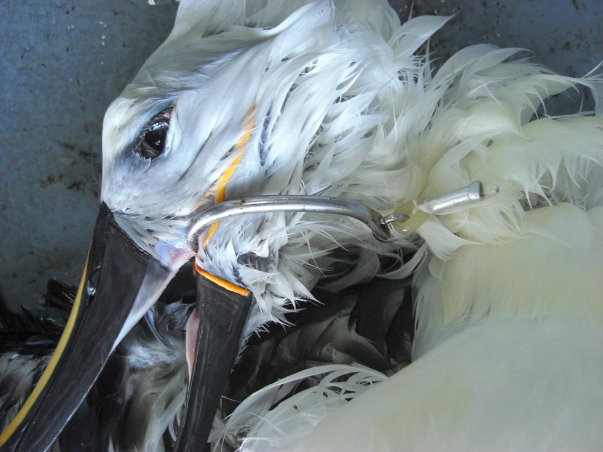
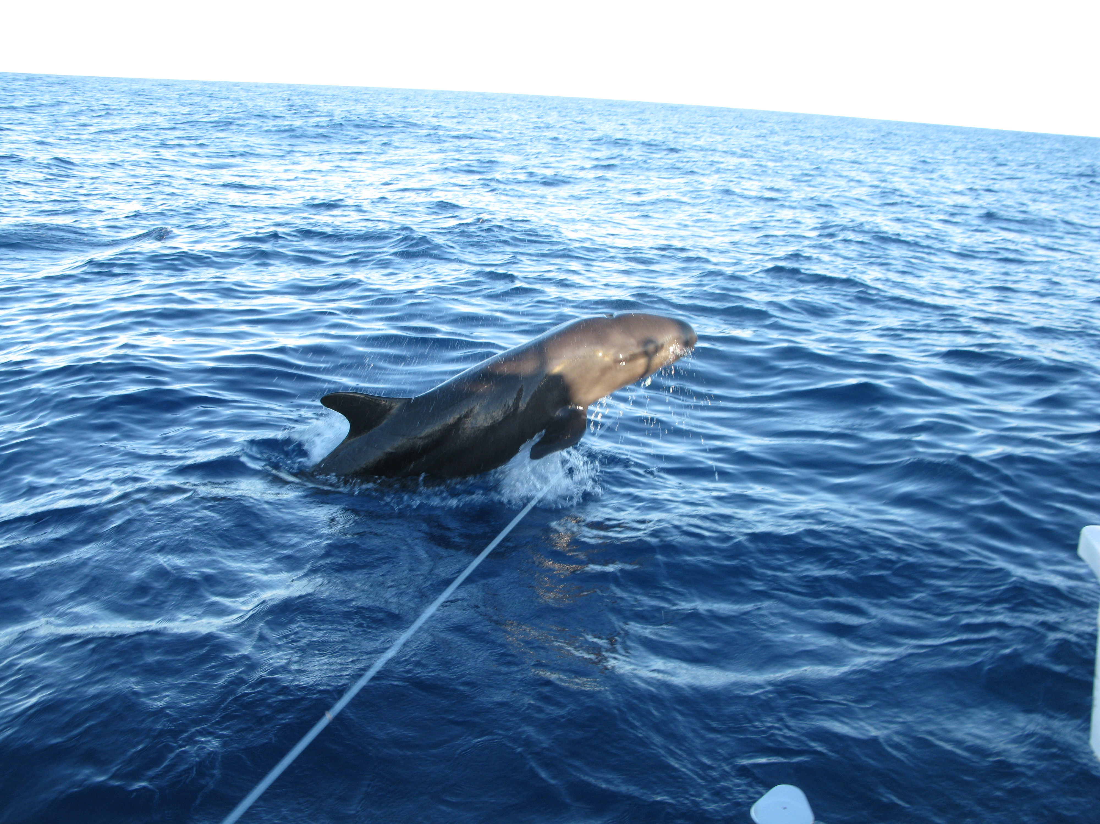
MADE Symposium, 15 – 19 octobre 2012, Montpellier
1 - RATIONALE
Due to this lack of selectivity (species and size), pelagic longline fisheries are likely the primary source of :
mortality of long-lived protected species (seabirds, sea turtles, marine mammals)
Bycatch of sharks, not targeted billfishes and juveniles swordfish
© M. Dachicourt
© A. Sharp
© S. Labart
… and fishing grounds where pelagic longlines are operating are called « Ocean Roulette » or « underwaters minefields » in the conservationist sphere ( Hinman, 1998).

Slide 3
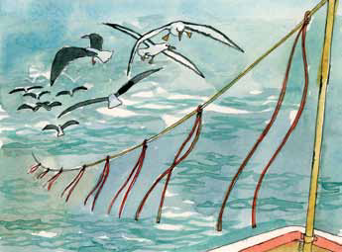
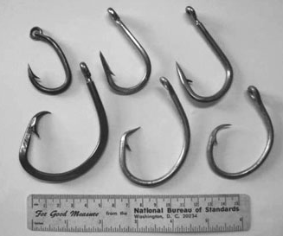
MADE Symposium, 15 – 19 octobre 2012, Montpellier
1 - RATIONALE
Bycatch mitigation measures in pelagic longlining
© Birdlife International
Many studies were focused on fishing practices and gear technology to mitigate bycatch of seabirds (tori line, night setting, weighted leader, …), sea turtles (hook shape, bait type, hooks out shallow waters, reducing soak time and daytime hauling) and sharks (prohibiting wire leader, hook shape)
(from Serafy et al.,, 2009)
Few studies on gear technology regarding the bait while bait is concerned at the different steps of the capture process from the detection of the gear by chemical stimuli, the detection of the bait and its attack by visual stimuli (Bjordal & Lokeborg, 1996; Ward, 2008)

Slide 4
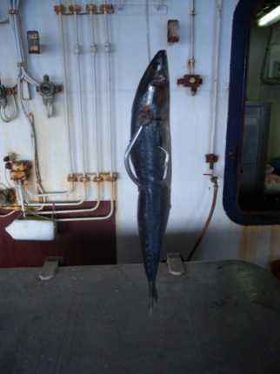
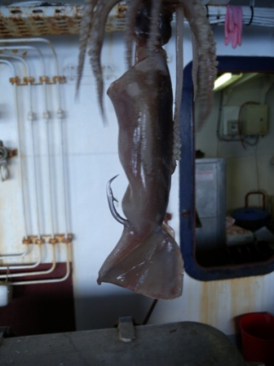
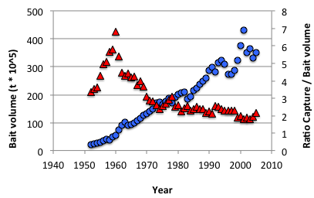
MADE Symposium, 15 – 19 octobre 2012, Montpellier
2 - DEVELOPMENT OF AN ARTIFICAL BAIT IN PELAGIC LONGLINING
WHY ?
1 – Improve the valorization of both fishery catches
and by-products
Mackerel Squid
350 000 mt of baits (180 gr ) used by pelagic longline fisheries/year worldwide =
~ ½ target species landings
(from Fontenau, 1997; 2009; 2010; com.. pers.)

Slide 5
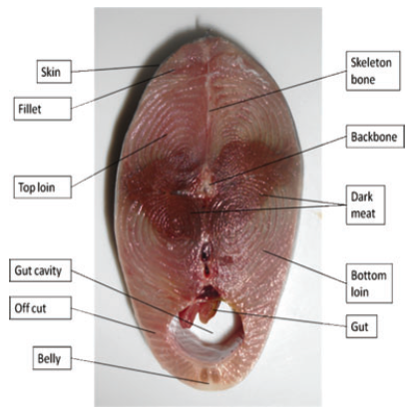
MADE Symposium, 15 – 19 octobre 2012, Montpellier
2 - DEVELOPMENT OF AN ARTIFICAL BAIT IN PELAGIC LONGLINING
WHY ?
1 – Improve the valorization of both fishery catches and by-products
Tuna industry produces a huge amount of solid wastes (450 000 mt/year of viscera, gills, dark flesh/muscle, head, bone, and skin),
(Sutanbawa Y, Aknes A. 2006)
As major byproducts (fish oil, fishmeal, fertilizer, pet food and fish silage) have still low economic values (Herpanti et al., 2011), solid wastes can be used for bait
(from Herpandi et al., 2011)

Slide 6
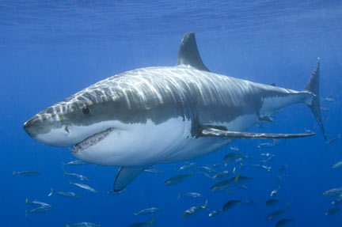
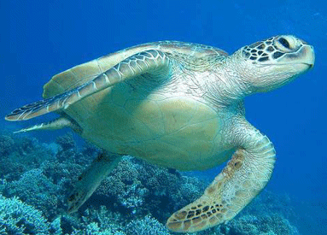
MADE Symposium, 15 – 19 octobre 2012, Montpellier
2 - DEVELOPMENT OF AN ARTIFICAL BAIT IN PELAGIC LONGLINING
WHY ?
2 – To reduce by-catch
Juveniles of target species
Sea turtles
Sharks
3 – To improve gear efficiency (reduce bait lost during soak time)
4 – Economy of the fishery
    Avoid baits out of stocks (small scale fishery)
    Reduce the bait part in the exploitation cost

Slide 7
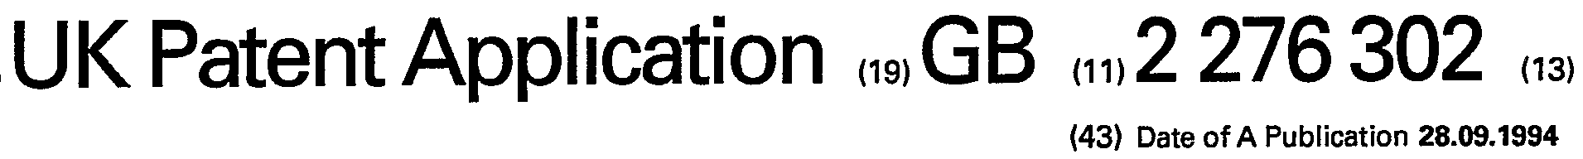

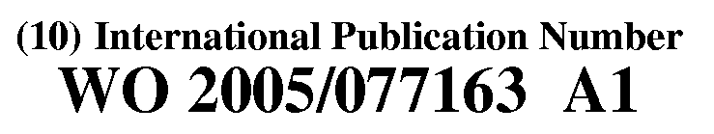
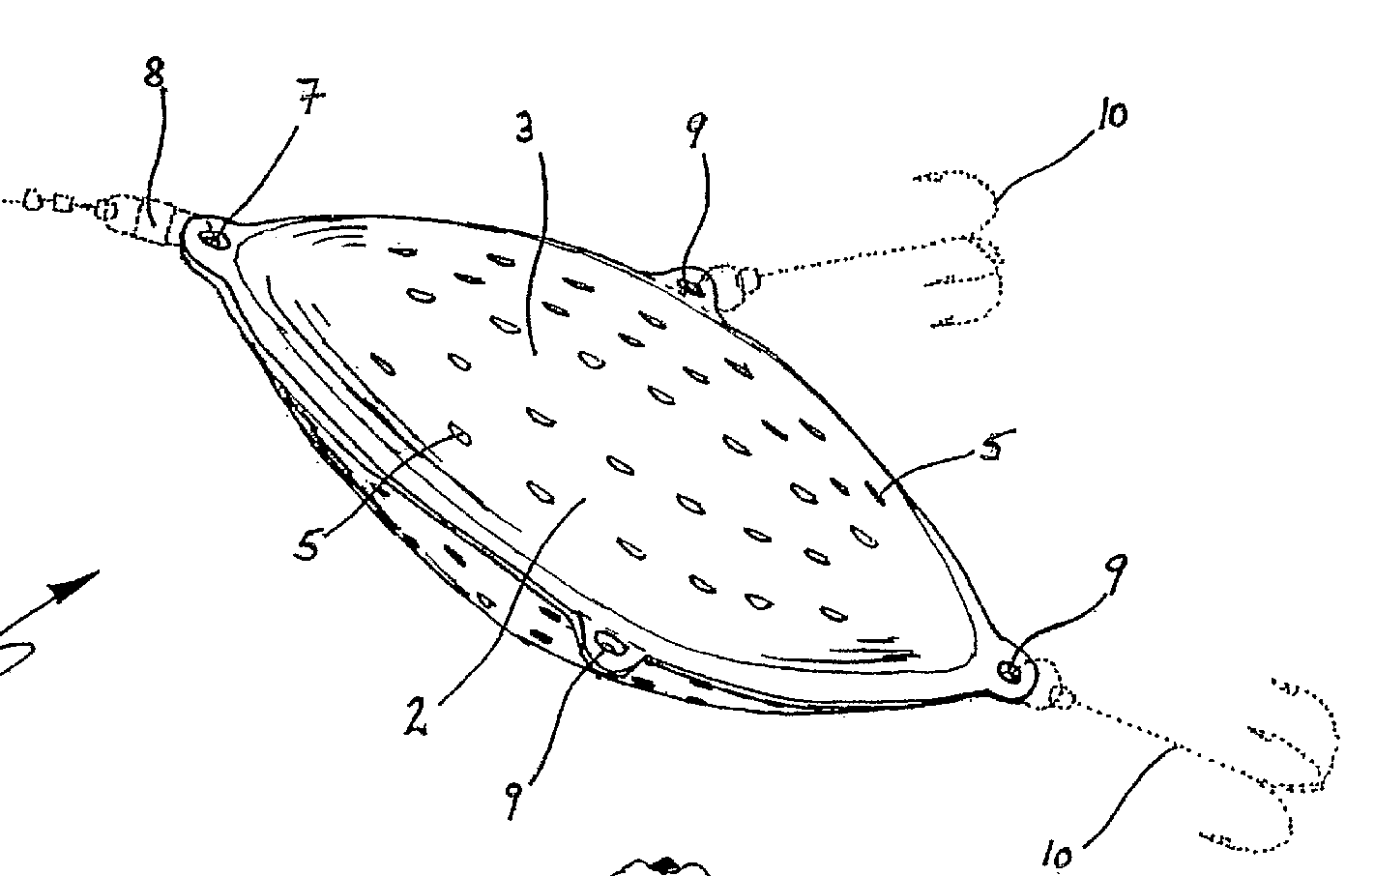
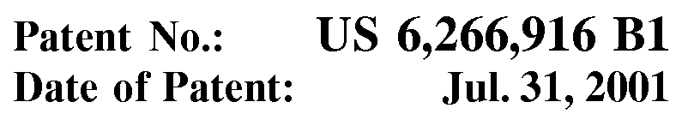
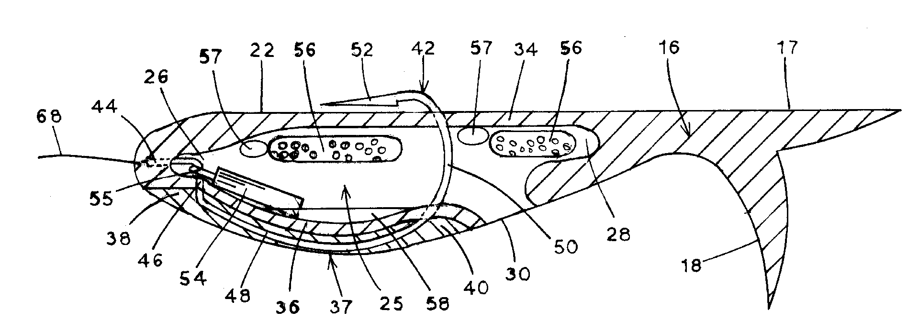
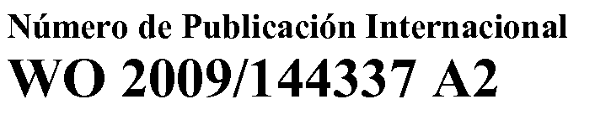
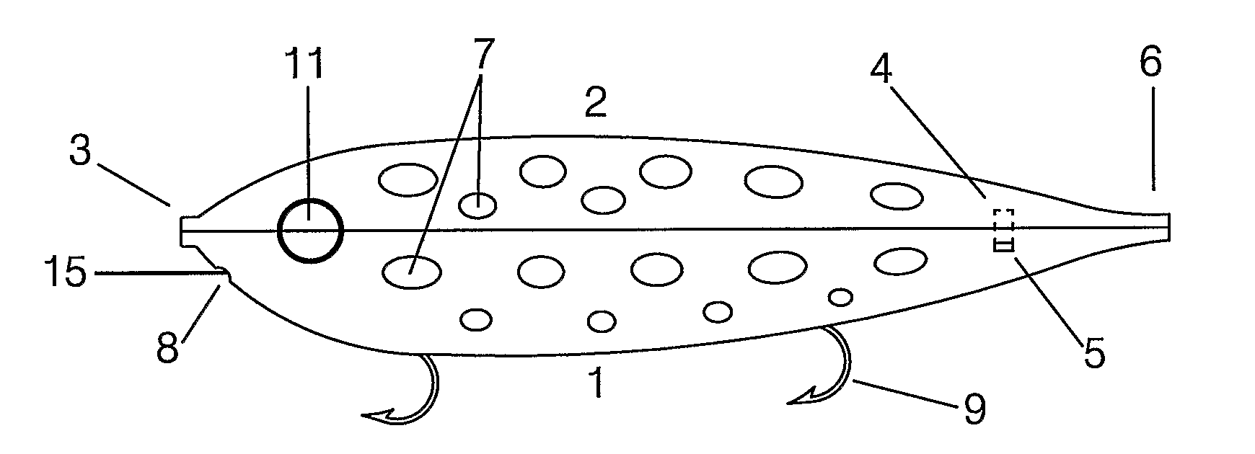
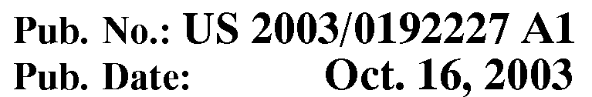
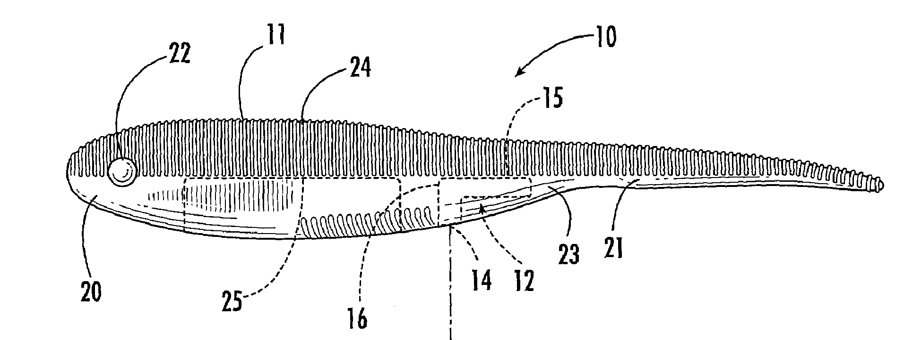
MADE Symposium, 15 – 19 octobre 2012, Montpellier
3 - ECOLOGICAL BASED ARTIFICIAL BAIT (EBAB) DEVELOPMENT
A - Exam of patented products with the National Institute
of the Intellectual Property
FISHING BAIT
FISH ATTRACTING FEED MANUFACTURED FROM FISHERY WASTES
Patent Number: JP10165110 A 19980623
FISHING BAIT
SMOOTH SOLID-SHAPED FISH BAIT AND METHOD FOR PRODUCING THE SAME
Patent Number: JP2010035434 A 20100218
FISH PLASTIC MOLD + FLESH
PLASTIC MOLD + FLESH
FISH PLASTIC MOLD + ATTRACTANT
FISH PLASTIC MOLD + FLESH
FISH PLASTIC MOLD + ATTRACTANT

Slide 8
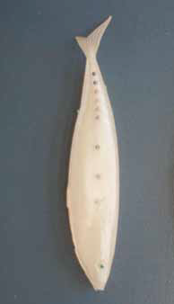
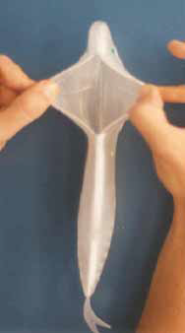
MADE Symposium, 15 – 19 octobre 2012, Montpellier
3 - ECOLOGICAL BASED ARTIFICIAL BAIT (EBAB) DEVELOPMENT
B -Exam of reports and scientific literature
Only 1 artificial bait application dedicated
for pelagic longline fisheries.
Tested in 1997 in the NE Atlantic to target
Swordfish:
Plastic bait only (0.13 /1000 h)
Plastic with fish oil (6.5 /1000 h)
Plastic with piece of mackerel (14 /1000 h)
* reference mackerel (14.7 /1000 h)
(from Mejuto et al., 2005)

Slide 9
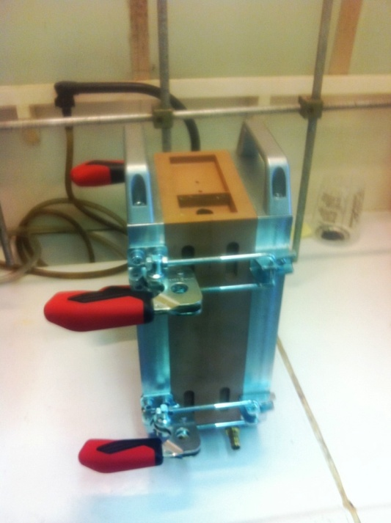
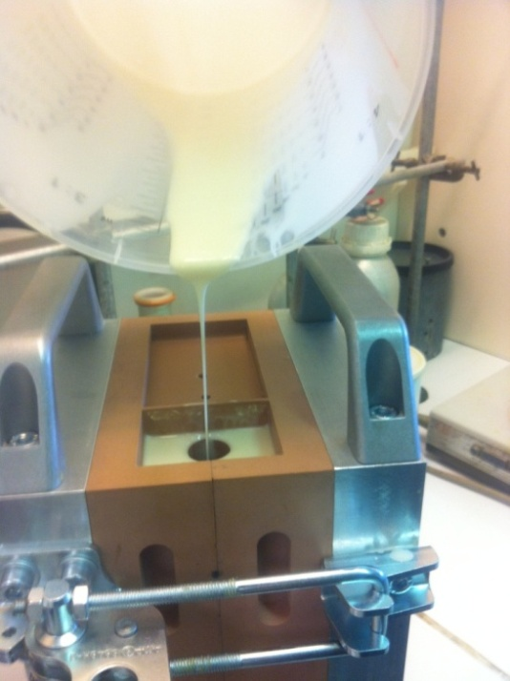
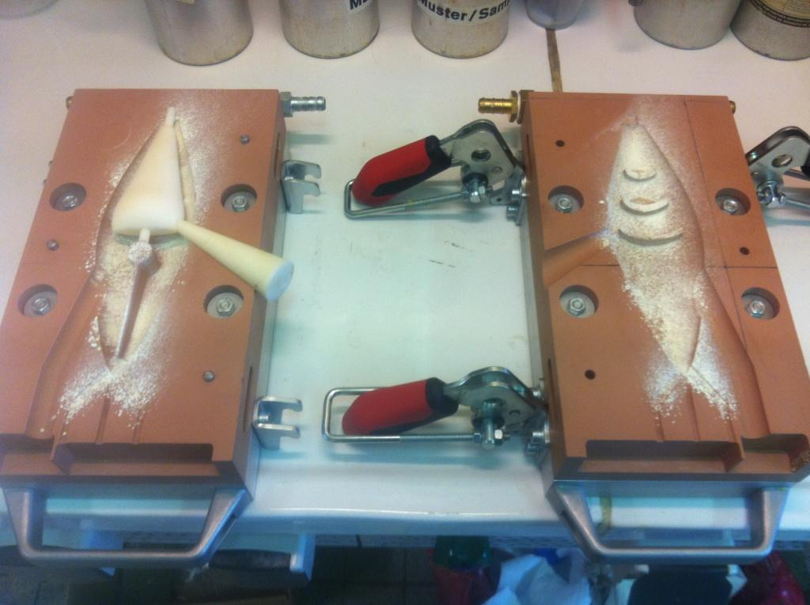
MADE Symposium, 15 – 19 octobre 2012, Montpellier
3 - ECOLOGICAL BASED ARTIFICIAL BAIT (EBAB) DEVELOPMENT
C – THE MOLD
Fish shape in monoblock
Polyurethane elastomer (resistance, flexibility)
  Reaction Injection Molding (RIM)
Mold structure preparation
Mold structure closed
Manual casting

Slide 10
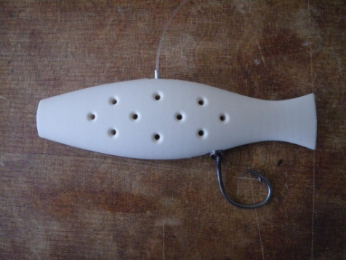
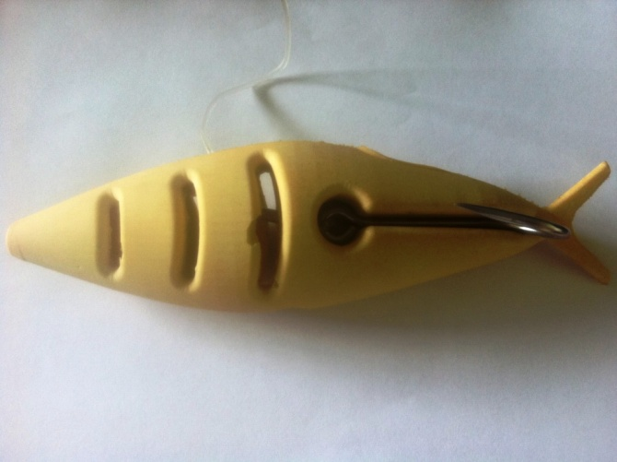
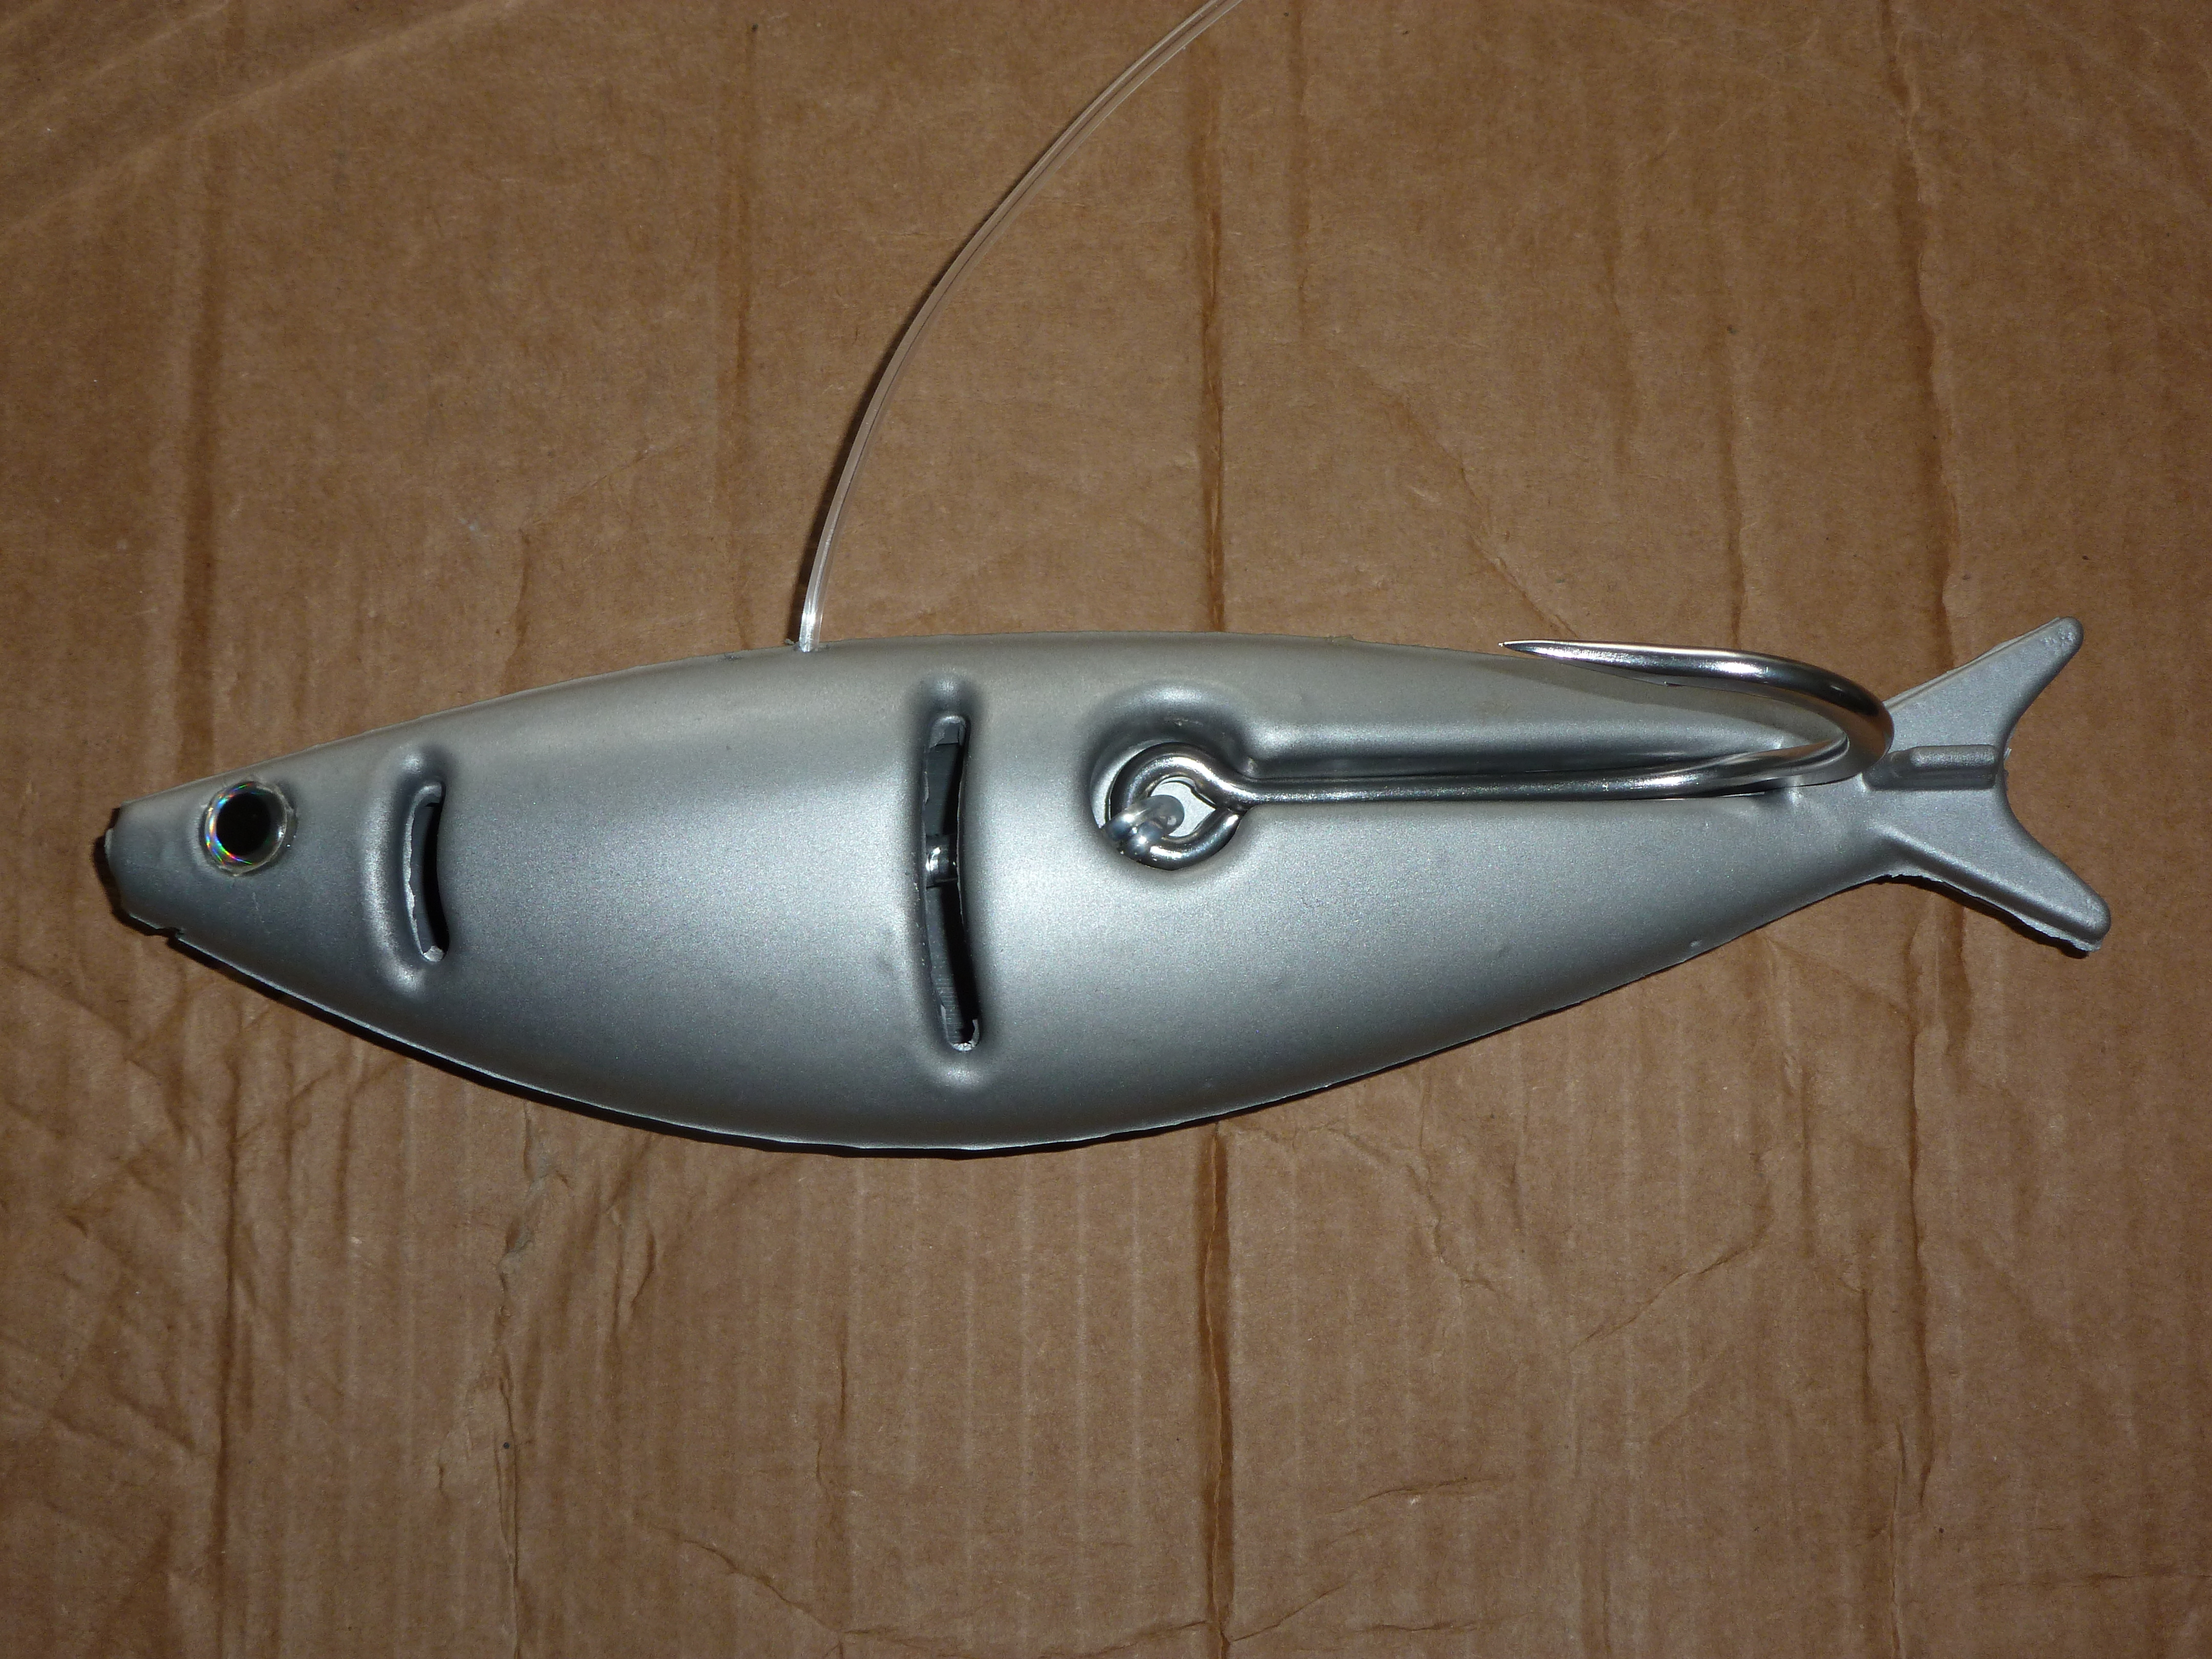
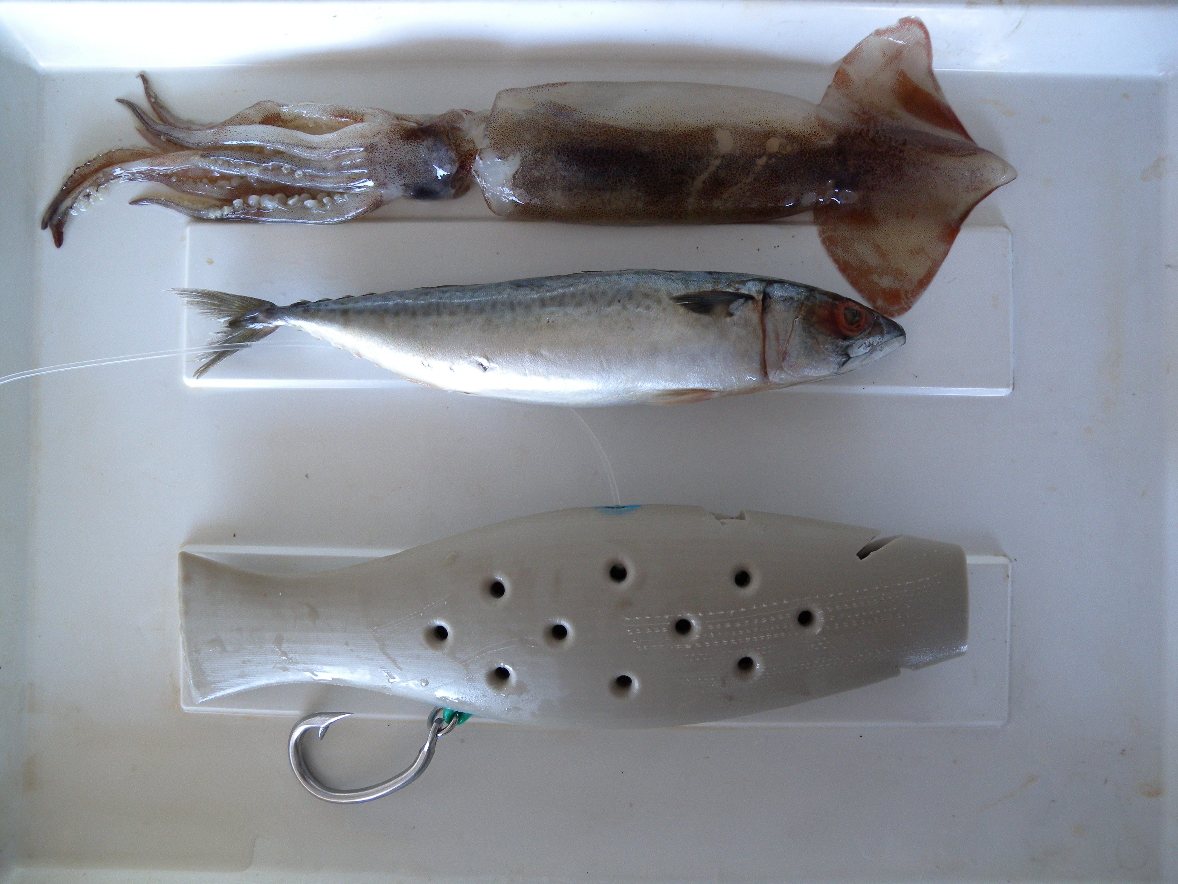
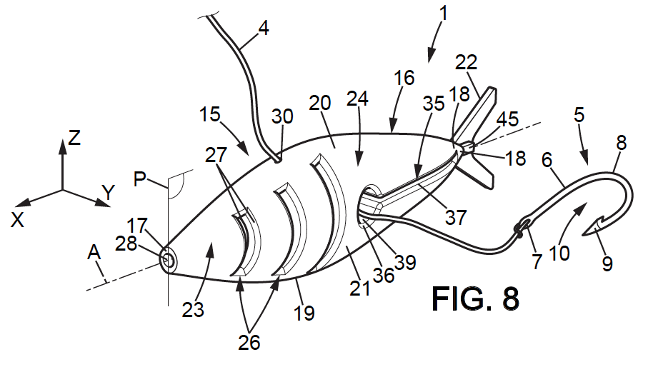
MADE Symposium, 15 – 19 octobre 2012, Montpellier
3 - ECOLOGICAL BASED ARTIFICIAL BAIT (EBAB) DEVELOPMENT
C – THE MOLD
28 cm
23 cm
23 cm
EBAB V1 (May 2010)
EBAB V2 (May 2011)
EBAB V2 (December 2011)
EBAB V1 (May 2010)
Bach P., Hodent T., & Robin J.-J., 2011.
Patent FR 11 58054, December 2011.

Slide 11

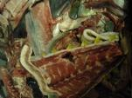

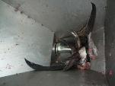


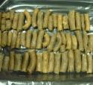
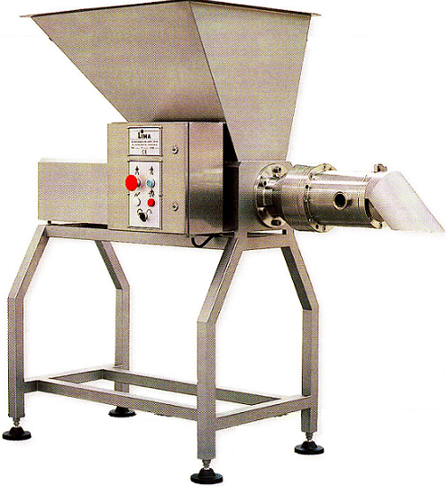
MADE Symposium, 15 – 19 octobre 2012, Montpellier
3 - EBAB DEVELOPMENT
Texturing :
carrageenan, konjac
Attractant:
Shrimp odor
D – THE PULP
4/ Pulp mixed
(attractive and
texturing products
1/ By-products
(tuna and swordfish)
Dispersive effect :
- Soap (5%, 15%, 25%)
- Salt (25%, 50%)
- Sand (5%, 15%, 25%, 50%)
- Fish flour (5%, 50%)
5/ Laboratory tests
2/ Mechanical
separation
(LIMA RM 70S)
6/ Pulp sausage
production
(Pulp roll ~ 7 cm, 25 gr)
3/ Raw pulp
(yield 70 %)

Slide 12
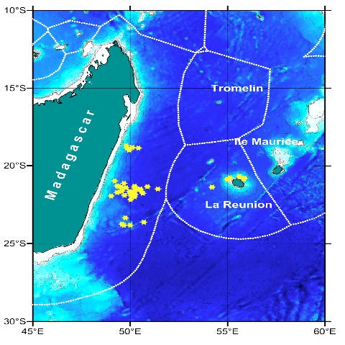
MADE Symposium, 15 – 19 octobre 2012, Montpellier
4 - EBAB FISHING TRIALS
EBAB V1 – December 2010
7 fishing sets
3500 natural baits / 420 EBABs (11%)
60 EBABs per set
EBAB V2 – July/August 2011
14 fishing sets
7000 natural baits / 1120 EBABs (14%)
80 EBABs per set
EBAB V3 – May/July 2012
46 fishing sets
56423 natural baits / 8563 EBABs (13%)
from 96 to 198 EBABs per set

Slide 13
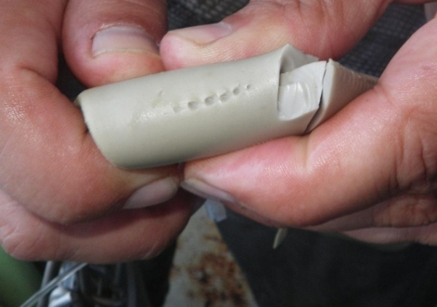
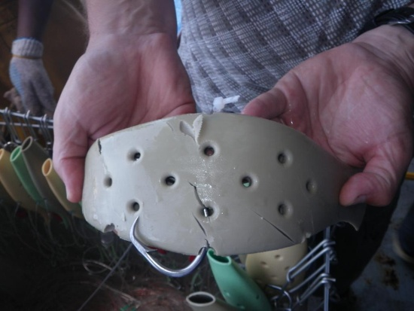
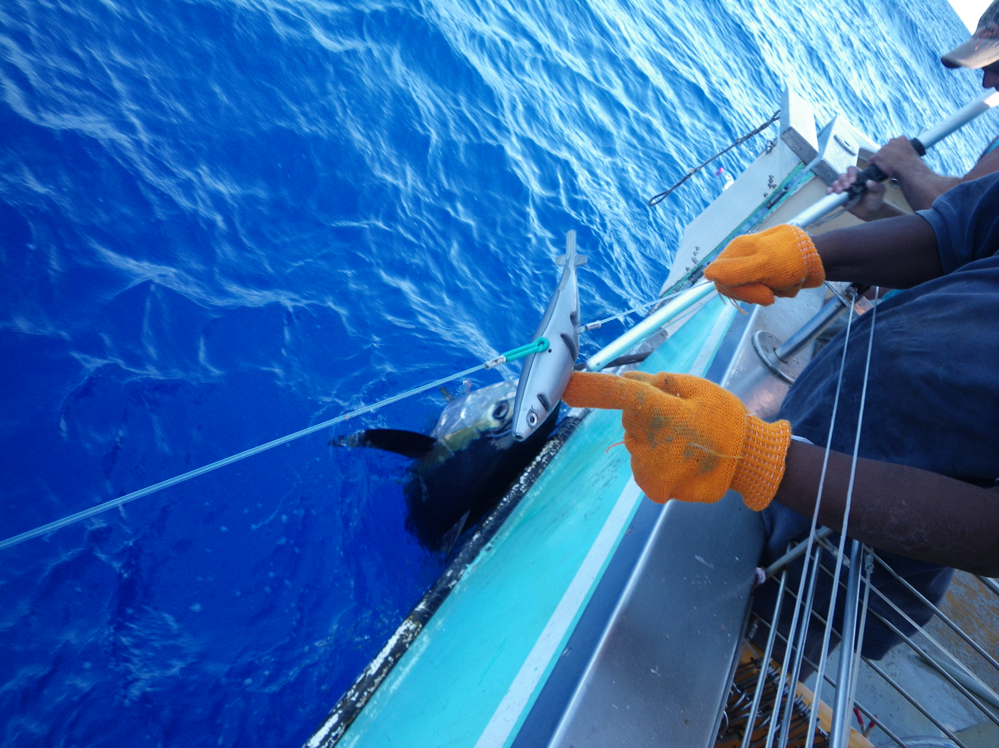
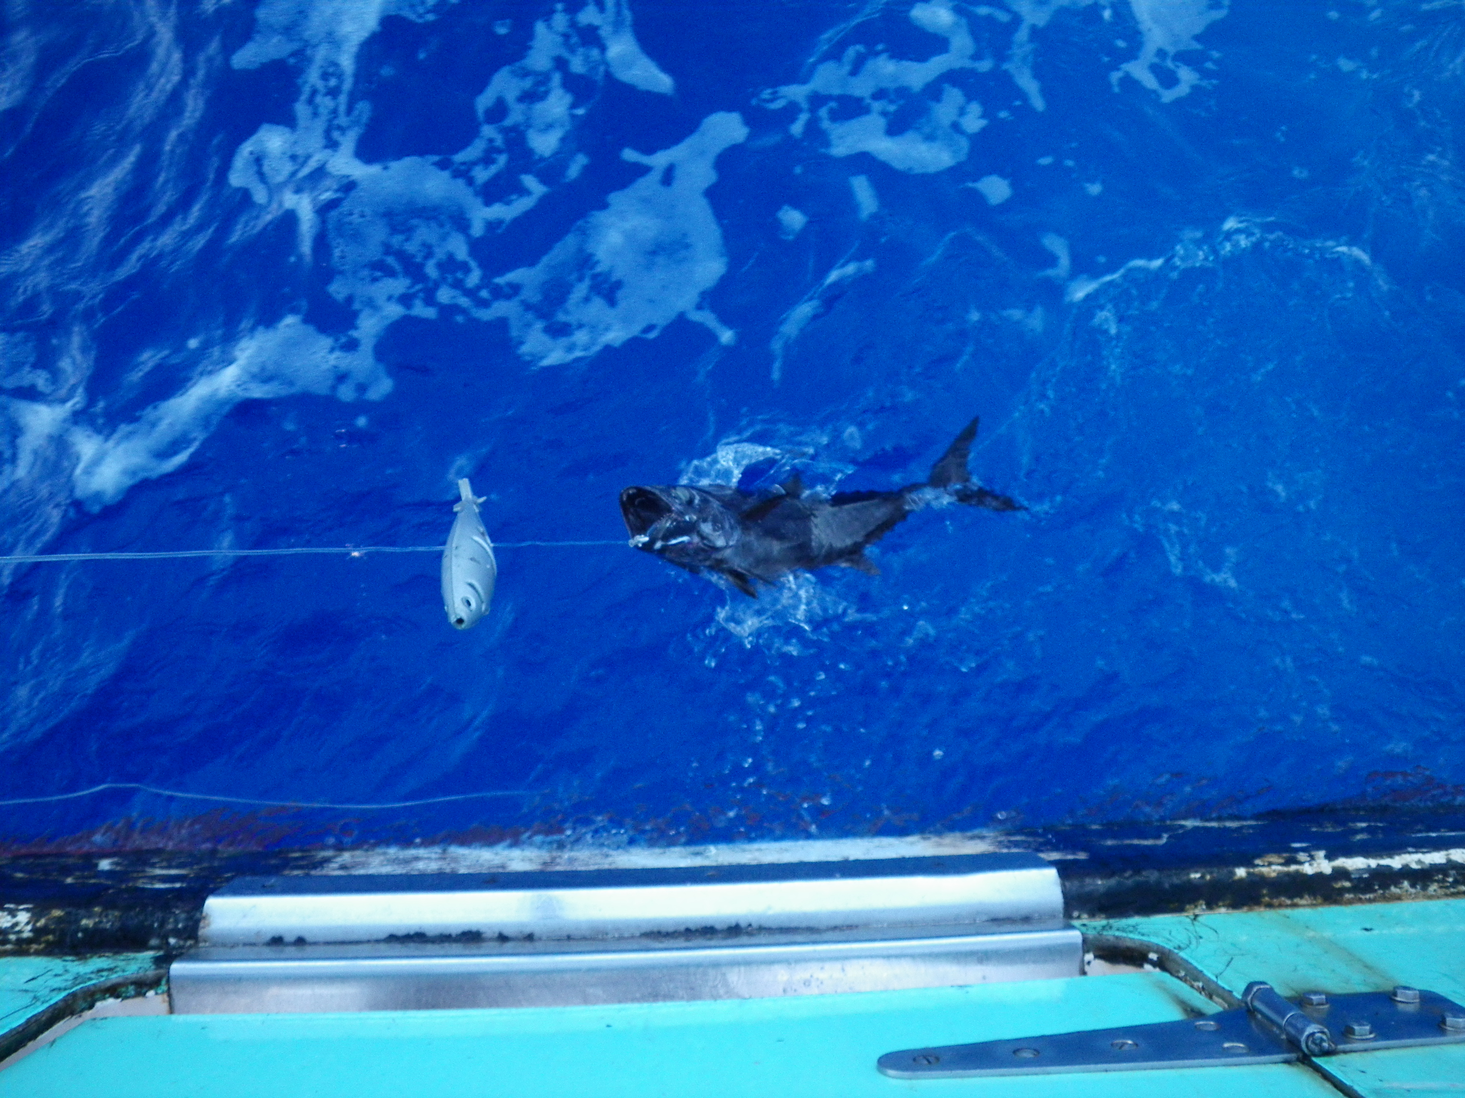
MADE Symposium, 15 – 19 octobre 2012, Montpellier
4 - EBAB FISHING TRIALS
Hooking contact and success on EBAB
Many hooking contacts observed on EBAB V1 and EBAB V2 but no success
Hooking success recorded
with EBAB V3

Slide 14
MADE Symposium, 15 – 19 octobre 2012, Montpellier
4 - EBAB FISHING TRIALS – RESULTS FOR EBAB V3
Positive fishing sets
Capture occurred in 17 fishing sets (37% of total fishing operations)
Tunas & swordfish occurred in 11 fishing sets (65% of positive sets)

Slide 15
MADE Symposium, 15 – 19 octobre 2012, Montpellier
Species or group of species | NATURAL BAIT | EBAB
TARGET AND MAJOR COMMERCIAL SPECIES
Swordish (Xiphia gladuis) | X | X
Albacore tuna (Thunnus alalunga) | X | X
Yellowfin tuna (Thunnus albacares) | X | X
Bigeye tuna (Thunnus obesus) | X | X
BYCATCH (conserved on board)
Marlin (Makaira spp, Tetrapterus audax) | X | X
Sailfish (Istiophorus platypterus) |  | X
Spearfish (Tertrapturus angustirostris) | X
Dolphinfish ( Corryphaena hippurus) | X
Opah (Lampris guttatus) | X
Barracuda (Sphyraena barracuda) | X
Bramids | X
Skipjack (Katsuwonus pelamis) | X
BYCATCH (Discards)
FINFISH
Escolar (Lepidocybium flavobrunneum) | X
Snake mackerel (Promethichtys promoteus) | X
Lancetfish (Alepisorus ferox, A. brevirostris) | X | X
Moonfish | X | X
ELASMOBRANCHS
Pelagic stingray (Pteroplatytrygon violacea) | X
Manta rays | X
Blue shark (Prionace glauca) | X | X
Oceanic white tip (Carcharhinus longimanus) | X | X
Requin gris (Requiem shark) | X
Mako shark (Isurus spp.) | X
Hammerhead shark (Sphyrna spp.) | X
PROTECTED SPECIES (discards)
Green turtle (Chelonia mydas) | X
Loggerhead sea turtle (Caretta caretta) | X
Risso's dolphin (Grampus griseus) | X | X
4 - EBAB FISHING TRIALS
Species selectivity
25 species or group of species caught by natural baits against 11 with EBAB V3
Tuna & swordfish caught with EBAB V3 (45% of total catches)
No pelagic stingray and dolphinfish caught with EBAB while they were abondant on hooks baited with natural baits
Risso’s dolphins caught with EBAB but no sea turtles

Slide 16
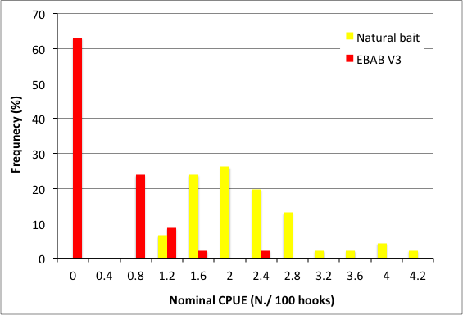
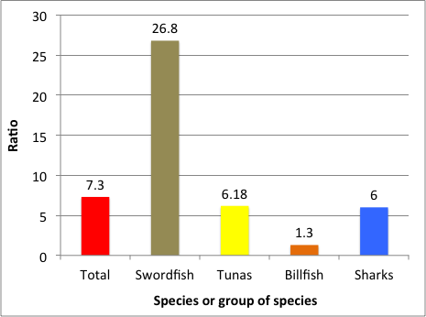
MADE Symposium, 15 – 19 octobre 2012, Montpellier
4 - EBAB FISHING TRIALS – RESULTS FOR EBAB V3
Capture rate (nominal CPUE) on EBAB V3 vs natural bait (total sets)
2.1
Ratio nCPUE bait / nCPUE EBAB
0.28
Frequency distribution of nCPUEs per set

Slide 17
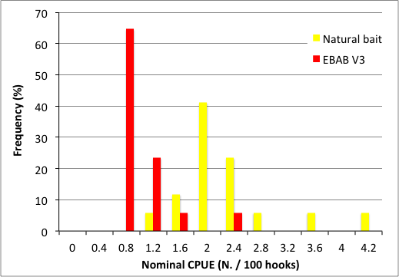
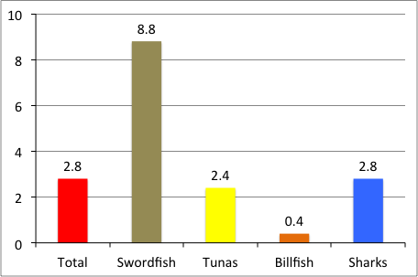
MADE Symposium, 15 – 19 octobre 2012, Montpellier
4 - EBAB FISHING TRIALS – RESULTS FOR EBAB V3
Capture rate (nominal CPUE) on EBAB V3 vs natural bait (positive sets on EBAB)
2.1
0.77
Ratio nCPUE bait / nCPUE EBAB
Frequency distribution of nCPUEs per set

Slide 18
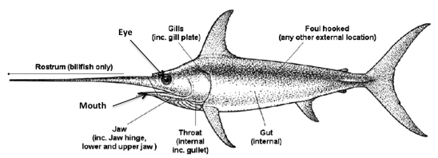
MADE Symposium, 15 – 19 octobre 2012, Montpellier
4 - EBAB FISHING TRIALS – RESULTS FOR EBAB V3
Hooking locations
12%
4%
72%
8%
(modified from Ward et al., 2009)
Entangled = 4%
2 hooking locations unknown due to escape of capture

Slide 19

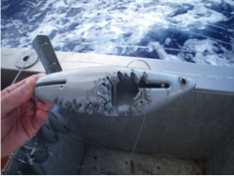
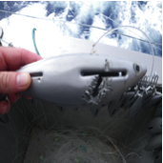
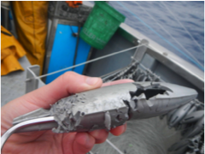
MADE Symposium, 15 – 19 octobre 2012, Montpellier
4 - EBAB FISHING TRIALS – RESULTS FOR EBAB V3
Loss & Damage rate of EBAB V3

Slide 20
MADE Symposium, 15 – 19 octobre 2012, Montpellier
5 - CONCLUSIONS
POSITIVE FEEDBACKS FROM EBAB V3
Capture of species of interest (principally tunas)
Good efficiency of the principle of the hook release from the mold
High rate of jaw and mouth hookings while J hook shape used
Low replacement rate
Great interest of fishermen in the research
NEGATIVE FEEDBACKS FROM EBAB V3
Low catch rate (ratio bait/EBAB, squid/EBAB, color, attractant, intempestive hook release)
Poor selective effect (species)
Rather good efficiency for billfish (J hook effect)

Slide 21
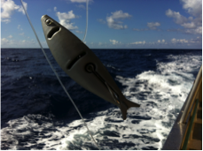
MADE Symposium, 15 – 19 octobre 2012, Montpellier
5 - CONCLUSIONS
Reducing fishing effort or time-area closure are
bycatch mitigation measures more cost-effective
than the delay and expense of technological
solutions (Jennings and Revill, 2007)
But
Gear technology has already played a central role in searching win-win solutions in the EAF framework,
Enhance both food security and valorization of sea by-products is an objective of the EAF
EBAB development combines these aspects of the EAF and put in place innovation for bait as a new challenge in pelagic longlining.

Slide 22
MADE Symposium, 15 – 19 octobre 2012, Montpellier
Session 6: MITIGATION TECHNIQUES IN LONGLINE FISHERIES
Bait innovation as a new challenge in pelagic longlining
Bach P., T. Hodent, C. Donadio, E. Romanov, L. Dufossé, J.-J. Robin
Special thanks to : H. Grenier, J.D. Filmater, J.P. Lamoureux, P. Cotel, E. Richard, A. Vastel, P. Le Bourdonnec, L. Le Foulgoc, Réunion Pélagique, ENEZ DU
Field trials partially supported by European Fishing Funds

